Slide 1
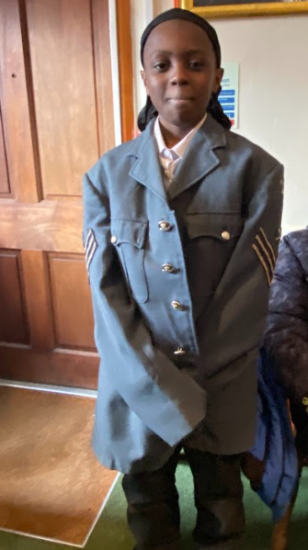
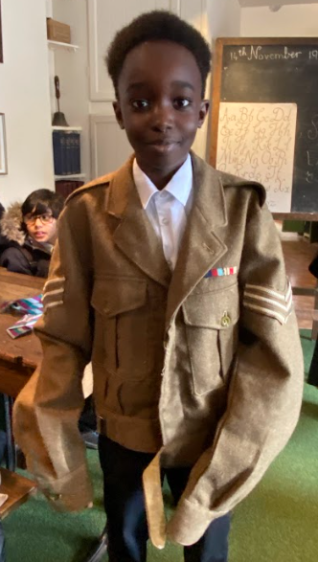
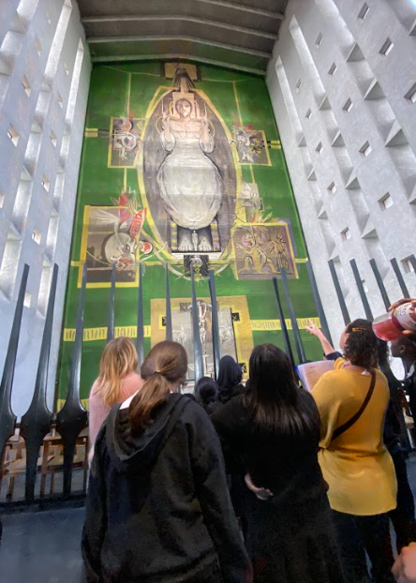
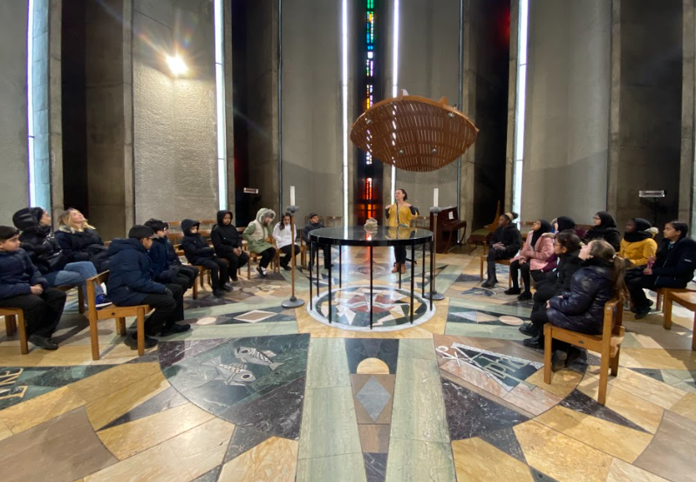
Yesterday, Year 6 went to Coventry Cathedral to continue their learning about WW2. We had a detailed tour around the cathedral and learned many facts about the ruins. Then we took part in some different workshops that had us thinking about rationing and being evacuated. It was a thrilling day and we have found out much more information that will help us through this topic.

